Slide 1

Healthy is the new happy –clinic database
Presented by Or elyahu
And Chen maimon

Slide 2
System requirements
as part of optimization process in "Healthy Is The New Happy" clinic we recognized a need for a new database system.
The system would help the management to see the statistic about the patients , the employees, what equipment to buy and what kinds of internships the doctors have.
in the doctors perspective the system would help them to check the patients health history, and help them to decide what treatment is the most efficient for their patients.

Slide 3
General description:
The "healthy is the new happy" clinic has an id, address, phone and a name.
In the clinic there are different kinds of employees such as doctors ,nurses and cleaners.
Every employee has a personal id, employee id, years of experience, salary.
Every doctor has a specialty and can analys a patient condition and give them medicine that will help them get better.
The clinic is very successful and contains many patients.
Each patient has a personal id, name, phone number, e-mail and address.
In the clinic we have many rooms such as nurse`s room, doctor`s room, labs and equipment room.
Every room has its own working hours, so the patients can be treated whenever its convenient for them.
The clinic is very equipped by our loyal supplier.
Each equipment has a serial number so it will be easy to order it from the supplier.

Slide 4
Two kinds of users that use the system:
1.managment:
Can see the information about the whole system: which doctor is most visited, what drug is the most profitable and what drug is the most used.
2. doctors:
Can see information only about the patients, the visit times and the appointments.
The doctors also diagnose the patient in the appointment and suggest a suitable treatment.

Slide 5
Description of Entities:
Healthy is the new happy clinic:
-clinc id, address, name , phone.
Personal info:
Personal id, name , address, phone, email
Patient:
Personal Id, clinc id.

Slide 6
Employee:
Personal id, employee id, exp years, salary, type , clinic id.
Doctor:
Doctor id, internship.
Nurse:
Nurse id.
Room:
Room num, type, clinic id
Doctor room:
Room num, doctor id, days, hours.

Slide 7
Nurse room:
Room num, nurse id, days, hours.
Equipment:
Serial num. supplier id, equipment name.
Equipment room:
Room num, equipment.
Supplier:
Personal id
Drug:
drug id, price, name, description

Slide 8
Appointment:
Appointment id, room num, patient id, doctor id, test num, date, hours.
Diagnose:
test num, result.
Treatment:
Treatment id, test num, doses, num of days.
Drug-appointment- match:
Appointment-id, drug-id.

Slide 9
Creation:
create schema HealthyIsTheNewHappy;
use HealthyIsTheNewHappy;
create Table Clinic
(Clinic_ID char(25) primary key NOT NULL,
Clinic_Name char(25),
Address char(25),
Phone int
)Engine = InnoDB;

Slide 10
create Table Drug
(Drug_ID char(25) primary key NOT NULL,
Price int,
Drug_Name char(25),
Drug_Description char(25)
)Engine = InnoDB;
create Table Personal_Info
(ID char(25) primary key NOT NULL,
Person_Name char(25),
Address char(25),
Phone int,
Email char(40)
)Engine = InnoDB;

Slide 11
create Table Personal_Info
(ID char(25) primary key NOT NULL,
Person_Name char(25),
Address char(25),
Phone int,
Email char(40)
)Engine = InnoDB;

Slide 12
create Table Employee
(ID char(25) NOT NULL,
E_ID char(25) NOT NULL,
expYears int not null,
salray long,
Type char(25),
Clinic_ID char(25),
Primary Key(E_ID,ID),
constraint fk_Clinic_Employee_doesnt_exists
foreign key (Clinic_ID) references Clinic(Clinic_ID),
constraint fk_ID_Employee_doesnt_exists
foreign key (ID) references Personal_Info(ID)
)Engine = InnoDB;

Slide 13
create Table Patient
(ID char(25) NOT NULL,
Clinic_ID char(25),
Primary Key(ID),
constraint fk_Clinic_Patient_doesnt_exists
foreign key (Clinic_ID) references Clinic(Clinic_ID),
constraint fk_ID_Patient_doesnt_exists
foreign key (ID) references Personal_Info(ID)
)Engine = InnoDB;

Slide 14
create Table Doctor
(Doctor_ID char(25) NOT NULL,
Intership char(50),
Primary Key(Doctor_ID),
constraint fk_Doctor_ID_Employee_doesnt_exists
foreign key (Doctor_ID) references Employee(E_ID)
)Engine = InnoDB;
Create Table Nurse(
Nurse_ID char(25) NOT NULL,
PRIMARY KEY (Nurse_ID),
constraint fk_Nurse_ID_Employee_dosent_exsists
foreign key (Nurse_ID) references Employee(E_ID)
) Engine = InnoDb;

Slide 15
Create Table Doctor_Room
(RoomNum char(25) NOT NULL,
Doctor_ID char(25) NOT NULL,
Days char(50),
Hours char(50),
Primary Key(RoomNum),
constraint fk_DoctorRoom_Room_doesnt_exists
foreign key (RoomNum) references Room(RoomNum),
constraint fk_Doctor_ID_doesnt_exists
foreign key (Doctor_ID) references Doctor(Doctor_ID)
)Engine = InnoDB;

Slide 16
Create Table Nurse_Room
(RoomNum char(25) NOT NULL,
Nurse_ID char(25) NOT NULL,
Days char(50),
Hours char(50),
Primary Key(RoomNum),
constraint fk_NurseRoom_Room_doesnt_exists
foreign key (RoomNum) references Room(RoomNum),
constraint fk_Nurse_ID_doesnt_exists
foreign key (Nurse_ID) references Nurse(Nurse_ID)
)Engine = InnoDB;

Slide 17
create Table Supplier
(Supplier_ID char(25) NOT NULL,
Primary Key(Supplier_ID),
constraint fk_ID_Supplier_doesnt_exists
foreign key (Supplier_ID) references Personal_Info(ID)
)Engine = InnoDB;
create Table Equipment
(SerialNum char(25) NOT NULL,
Supplier_ID char(25) NOT NULL,
Equipment_Name char(25),
Primary Key(SerialNum),
constraint fk_Supplier_doesnt_exists
foreign key (Supplier_ID) references Supplier(Supplier_ID)
)Engine = InnoDB;

Slide 18
create Table Equipment_Room
(RoomNum char(25) NOT NULL,
EquipmentSerial char(25) NOT NULL,
constraint fk_Equipment_Room_doesnt_exists
foreign key (RoomNum) references Room(RoomNum),
constraint fk_Equipment_SerialNum_doesnt_exists
foreign key (EquipmentSerial) references Equipment(SerialNum)
)Engine = InnoDB;
create Table Diagnose
(TestNum char(25) NOT NULL,
Result char(100),
Primary Key(TestNum)
)Engine = InnoDB;

Slide 19
create Table Treatment
(Treatment_ID char(25) NOT NULL,
TestNum char(25) NOT NULL,
Doses char(25),
NumDays char(25),
Primary Key(Treatment_ID),
constraint fk_Treatment_TestNum_doesnt_exists
foreign key (TestNum) references Diagnose(TestNum)
)Engine = InnoDB;

Slide 20
create Table Appointment (Appointment_ID char(25) NOT NULL, RoomNum char(25) NOT NULL, Patient_ID char(25) NOT NULL, Doctor_ID char(25) NOT NULL, TestNum char(25) NOT NULL, Date char(25), Hours char(50), Primary Key(Appointment_ID), constraint fk_Appointment_RoomNum_doesnt_exists foreign key (RoomNum) references Room(RoomNum), constraint fk_Appointment_Patient_ID_doesnt_exists foreign key (Patient_ID) references Patient(ID), constraint fk_Appointment_Doctor_ID_doesnt_exists foreign key (Doctor_ID) references Doctor(Doctor_ID), constraint fk_Appointment_TestNum_doesnt_exists foreign key (TestNum) references Diagnose(TestNum) )Engine = InnoDB;

Slide 21
create Table Appointment_Drug_Match
(Appointment_ID char(25) NOT NULL,
Drug_ID char(25) NOT NULL,
primary key (Appointment_ID,Drug_ID),
foreign key (Drug_ID) references Drug(Drug_ID),
foreign key (Appointment_ID) references Appointment(Appointment_ID)
)Engine = InnoDB;

Slide 22
Insertion:
#Clinic
insert into Clinic values (1,'HealthyIsTheNewHappy', 'Hagiborim4', 5599);
#Drug
insert into Drug values
(1,100,'Acamol','release pains'),
(2,150,'Kal Beten','abdominal pain'),
(3,100,'Cough syrup','ease the cough'),
(4,200,'Eye Drop', 'aginst red eyes'),
(5,120, 'Acamol Tzinon','effective aginst tzinon');

Slide 23
#Personal_Info insert into Personal_Info values (312345678,'Menahem','Tziyonot 15',0501111111,'Menahem@gmail.com’), (212385679,'Shifra','Tzlil 20',0502222222,'Shifra@gmail.com’), (245685690,'Moshe','Root 40',0503333333,'Moshe@walla.com’), (245642310,'Peretz','HaiBus 15',0504444444,'Seleb@walla.com’), (248185690,'David','England 1',0501234567,'Something@Yello.com’), (245681057,'Ania','Rus 1',05055555555,'Ania@gmail.com’), (285285690,'Moshe','Zihron 17',0507777777,'Moshe12@walla.com’), (305685690,'Ogen','Maimia 2',0545733333,'Ogen@walla.com’), (312685690,'Sason','Shemesh 12',0521333333,'Sason@walla.com’), (012685690,'Smile','Bezeq 9',0541111111,'StamKiBaLiLedaber@walla.com’), (012885690,'Rooti','Hapina 5',0579561222,'Rooti@gmail.com’), (085685680,'Tzedi','Tarfati 5',0548233340,'Tzedi@gmail.com’), (345185670,'Zulema','Spain 3',0525933380,'Zulema@walla.com’), (312685660,'Zelda','gamboy 41',0521212121,'Zelda@walla.com’), (325689490,'Yehuda','Levi 2',0501248213,'Yehuda@gmail.com’), (211123644,'Macarena','Sefi 15',0524096333,'Macarena@walla.com’), (245055134,'Saray','Jail 80',0541280333,'Saray@walla.com');

Slide 24
#Room
insert into Room values
(1, 'Lab',1),
(2, 'Lab',1),
(3, 'Lab',1),
(4, 'Lab',1),
(5, 'Doctor',1),
(6, 'Doctor',1),
(7, 'Doctor',1),
(8, 'Doctor',1),
(9, 'Nurse',1),
(10, 'Nurse',1),
(11, 'Equipment',1),
(12, 'Equipment',1);

Slide 25
#Employee
insert into Employee values
(312345678,1,40,40000,'Doctor',1),
(212385679,2,20,30000,'Doctor',1),
(245685690,3,30,35000,'Doctor',1),
(245642310,4,25,25000,'Doctor',1),
(248185690,5,3,6000,'Nurse',1),
(245681057,6,4,7000,'Nurse',1),
(285285690,7,1,6000,'Cleaner',1),
(305685690,8,2,6000,'Cleaner',1),
(012885690,9,7,8000,'Rentgen',1);

Slide 26
#Patient
insert into Patient values
(085685680,1),
(345185670,1),
(312685660,1),
(325689490,1),
(211123644,1),
(245055134,1);
#Doctor
insert into Doctor values
(1,'AfHozenGaron'),
(2,'Family'),
(3,'Ortoped'),
(4,'Family');

Slide 27
#Nurse
insert into Nurse values
(5),
(6);
#Doctor_Room
insert into Doctor_Room values
(5, 1,'SunMonTue','10:00-14:00'),
(6, 2,'TueWenThu','14:00-18:00'),
(7, 3,'FriSau','00:00-10:00'),
(8, 4,'AllWeek','10:00-17:00');

Slide 28
#Nurse_Room insert into Nurse_Room values (9, 5,'AllWeek','10:00-17:00’), (10, 6,'AllWeek','17:00-22:00');
#Supplier insert into Supplier values (312345678);
#Equipment insert into Equipment values (1,312345678,'Pad’), (2,312345678,'Needle’), (3,312345678,'Siezers’), (4,312345678,'Tape’), (5,312345678,'TestTube’), (6,312345678,'Lalipop’), (7,312345678,'VeinStoper');

Slide 29
#Equipment_Room
insert into Equipment_Room values
(11 ,1),
(11, 2),
(11, 3),
(11, 4),
(12, 1),
(12, 5),
(12, 6),
(12, 7);

Slide 30
#Diagnose
insert into Diagnose values
(1,'Suffer from normal headache, no fever included'),
(2,'Suffer from pain in throat'),
(3,'Period'),
(4,'Fever'),
(5,'Suffer from snoozness!:D (and winter is coming...)'),
(6,'Alergic to SQL');

Slide 31
#Treatment
insert into Treatment values
(1, 1, '5 Pills', 2),
(2, 2, '150mg', 7),
(3, 3, '3 Pills', 3),
(4, 4, '9 Pills', 3),
(5, 5, '9 Pills', 3),
(6, 6, 'Re-Course', 1);

Slide 32
#Appointment
insert into Appointment values
(1,5,085685680,1,1,'Sun','10:00-10:05'),
(2,6,345185670,1,2,'Mon','14:00-14:05'),
(3,7,312685660,2,3,'Fri','14:30-14:40'),
(4,5,325689490,3,4,'Sun','11:00-11:20'),
(5,8,211123644,3,5,'Sun','11:20-11:25'),
(6,8,245055134,3,6,'Tue','11:30-13:00');

Slide 33
#Appointment_Drug_Match
insert into Appointment_Drug_Match values
(1,1),
(2,3),
(3,1),
(4,5),
(5,5),
(6,4);

Slide 34
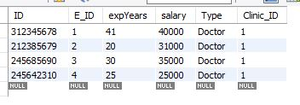

Queris:
Select all employees that are doctors:
select * from Employee
where Type like 'Doctor';
Select who is the most experienced doctor:
select * from Employee
where expYears = (
select max(expYears) from Employee
where Type like 'Doctor');

Slide 35


Select the most paid employee
select * from Employee where salary = ( select max(salary) from Employee);
Retrieve list of patient id from the most visited doctor: select Patient_ID,Appointment.Doctor_ID from Appointment, (select count(Doctor_ID) as Count, Doctor_ID from Appointment as A group by Doctor_ID order by Count desc limit 1) as temp where Appointment.Doctor_ID = temp.Doctor_ID;

Slide 36

Retrieve personal info about the most visited doctor: select Personal_info.* from Personal_info, (select distinct ID from Employee, (select Patient_ID,Appointment.Doctor_ID from Appointment, (select count(Doctor_ID) as Count, Doctor_ID from Appointment as A group by Doctor_ID order by Count desc limit 1) as temp where Appointment.Doctor_ID = temp.Doctor_ID) as PatDocID where Employee.E_ID = PatDocID.Doctor_ID) as Details where Personal_info.ID = Details.ID;

Slide 37

Retrieve the most profit drug and its name:
select Drug.*, temp.profit from Drug, (select M.Drug_ID, count(M.Drug_ID) as Count, D.Price, count(M.Drug_ID)*D.price as Profit from Appointment_Drug_match as M, Drug as D where M.Drug_ID = D.Drug_ID group by Drug_ID order by profit desc limit 1) as temp where temp.Drug_ID = Drug.Drug_ID;

Slide 38

retrieve treatment for snoznes: select treatment.* from treatment, (select * from Diagnose where result like '%snoozness%') as temp where treatment.TestNum = temp.testNum;

Slide 39
Retrieve which hours nurse id 5 is working and what are her deatiles: select Personal_info.*, Details.E_ID, Details.Hours from Personal_info, (select Employee.ID,Employee.E_ID, NurseInfo.Hours from Employee, (select Nurse.nurse_ID, temp.Hours from Nurse, (select nurse_ID,Hours from nurse_room where nurse_ID = 5) as temp where Nurse.nurse_ID = temp.nurse_ID) as NurseInfo where Employee.E_ID = NurseInfo.nurse_ID) as Details where Personal_info.ID = Details.ID;

Slide 40

Retrieve details about the 2 most visited rooms: select Room.RoomNum, Room.Type rom room, (select Count(RoomNum) as NumOfVisits, RoomNum from Appointment group by RoomNum order by NumOfVisits desc limit 2) as RoomDetails where Room.RoomNum = RoomDetails.RoomNum;

Slide 41

Retrieve all the equipment in room 11(equipment room): select equipment.equipment_Name from equipment, (select * from equipment_room where roomNum = 11) as temp where equipment.SerialNum = temp.EquipmentSerial;

Slide 42

Retrieve the rooms that contain pads: select equipment_room.roomNum, temp.Equipment_Name from equipment_room, (select serialNum,Equipment_Name from Equipment where Equipment_Name like 'pad') as temp where equipment_room.equipmentSerial = temp.serialNum;

Slide 43

Retrieve a worker name 'Moshe' which is a doctor and return his details:
select equipment_room.roomNum, temp.Equipment_Name
from equipment_room,
(select serialNum,Equipment_Name
from Equipment
where Equipment_Name like 'pad') as temp
where equipment_room.equipmentSerial = temp.serialNum;

Slide 44
Triggers:
create table Employee_log (ID char(25), old_E_ID char(25), new_E_ID char(25), new_old_expYears int, new_expYears int, old_salary int, new_salary int, Type char(25), Clinic_ID char(25), command_ts timestamp, command varchar(10) )Engine = InnoDB;

Slide 45
delimiter $
CREATE TRIGGER emp_ins_trg AFTER INSERT ON Employee
FOR EACH ROW
BEGIN
INSERT INTO Employee_log VALUES(new.id, null, new.E_ID , null, new.expYears, null, new.salary,new.Type, new.Clinic_ID, now(), 'insert');
END$
delimiter ;

Slide 46
delimiter $
CREATE TRIGGER emp_upd_trg AFTER UPDATE ON Employee
FOR EACH ROW
BEGIN
INSERT INTO Employee_log VALUES(new.id, old.E_ID, new.E_ID , old.expYears, new.expYears, old.salary, new.salary,new.Type, new.Clinic_ID, now(), 'update');
END$
delimiter ;

Slide 47
delimiter $
CREATE TRIGGER emp_del_trg AFTER DELETE ON Employee
FOR EACH ROW
BEGIN
INSERT INTO Employee_log VALUES(old.id, old.E_ID, null , old.expYears, null, old.salary, null ,null, old.Clinic_ID, now(), 'delete');
END$
delimiter ;

Slide 48
Insert:
insert into Employee values
(312345678,1,40,40000,'Doctor',1),
(212385679,2,20,30000,'Doctor',1),
(245685690,3,30,35000,'Doctor',1),
(245642310,4,25,25000,'Doctor',1),
(248185690,5,3,6000,'Nurse',1),
(245681057,6,4,7000,'Nurse',1),
(285285690,7,1,6000,'Cleaner',1),
(305685690,8,2,6000,'Cleaner',1),
(012885690,9,7,8000,'Rentgen',1);

Slide 49
Update:
update Employee
set expYears = 41
where E_ID = 1;
update employee
set salary = 31000
where E_ID = 2;
Delete:
delete from Employee
where E_ID = 9;

Slide 50
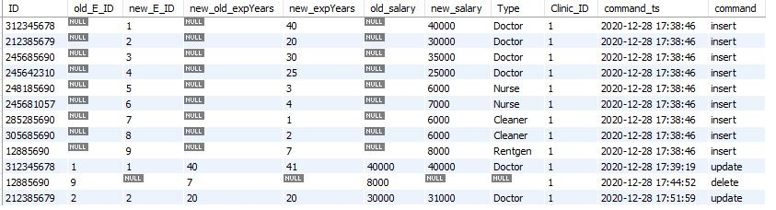
After changes:

Slide 51
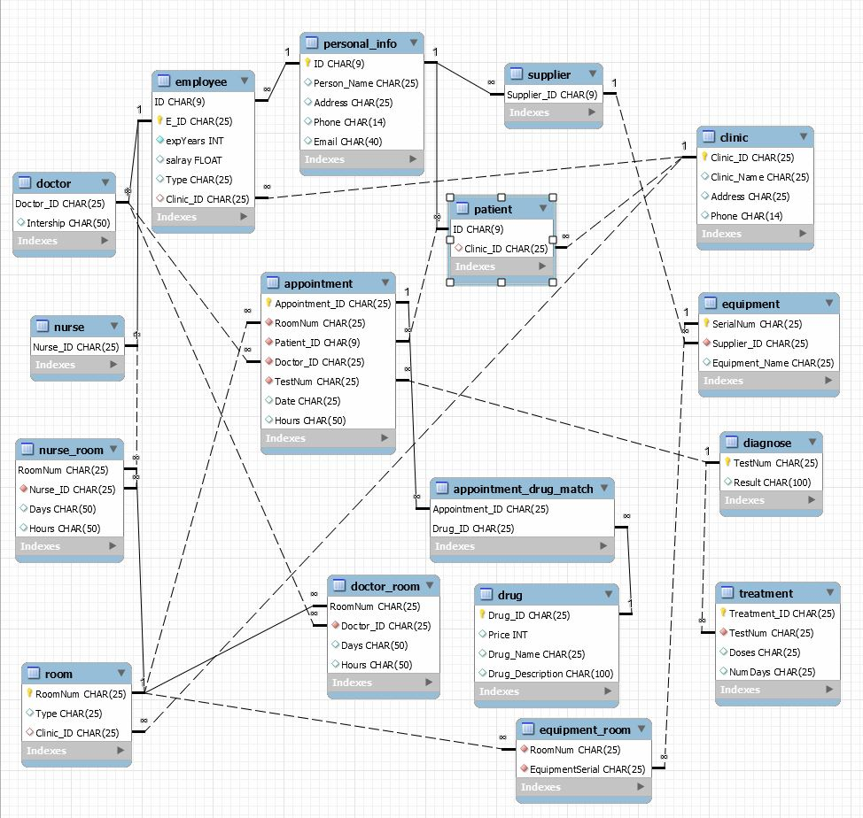

Slide 52
